Slide 1
School Idol Tomodachi Chiharu Szalay

Slide 2

Your Title
Some info

Slide 3
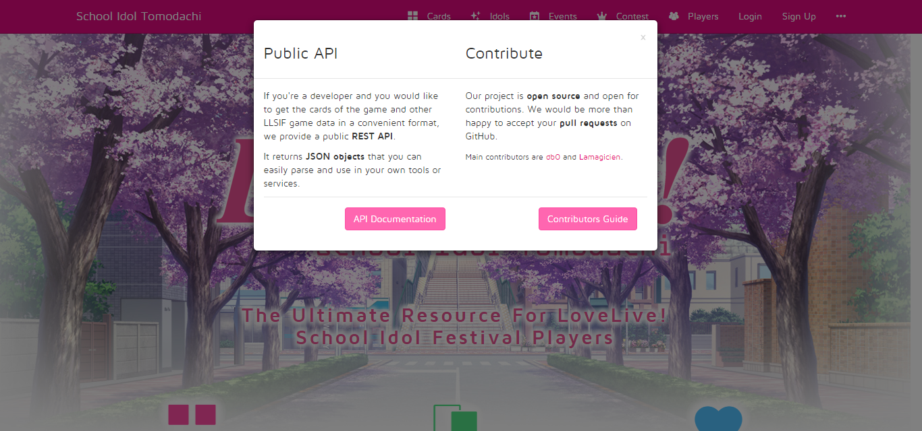

Slide 4
Django, Pyramid, LESS CSS, Bootstrap, JQuery, Bower

Slide 5
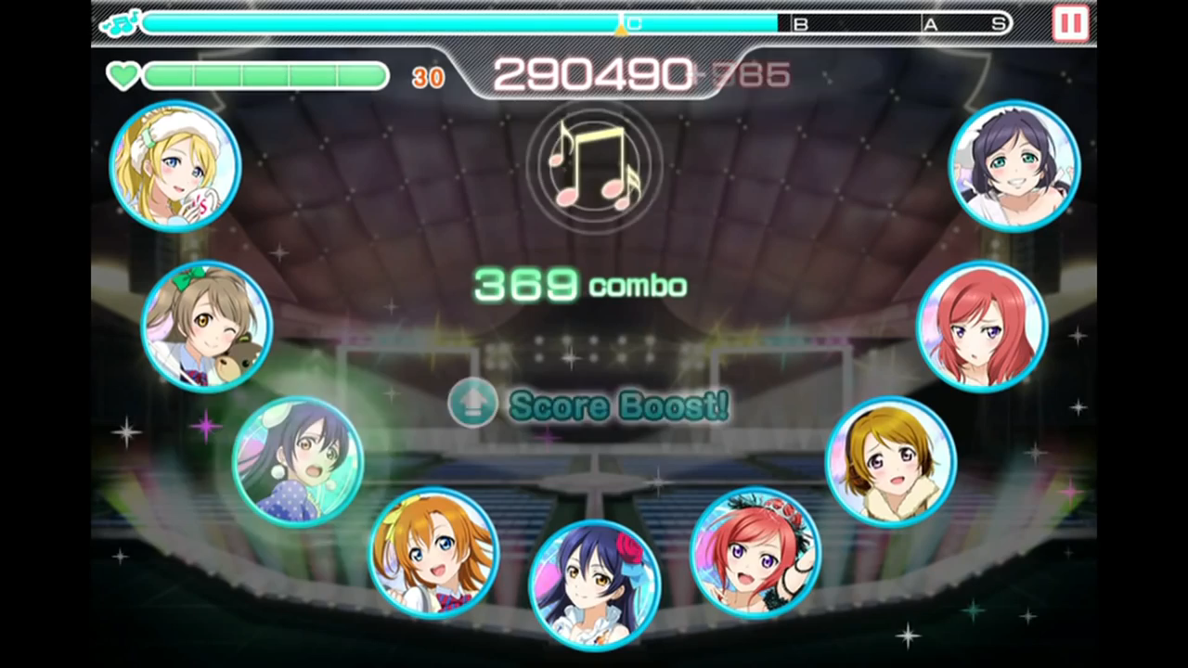
Your Title
Some info

Slide 6
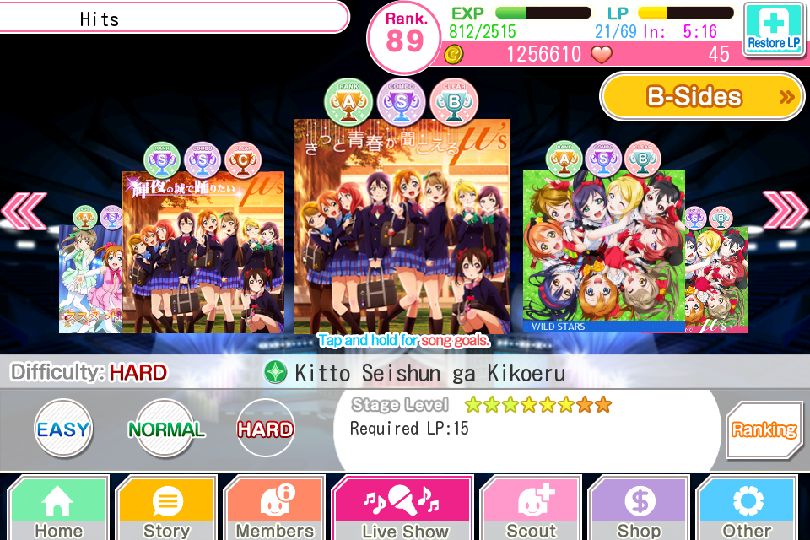
Your Title
Some info

Slide 7
Your Title
Some info

Slide 8
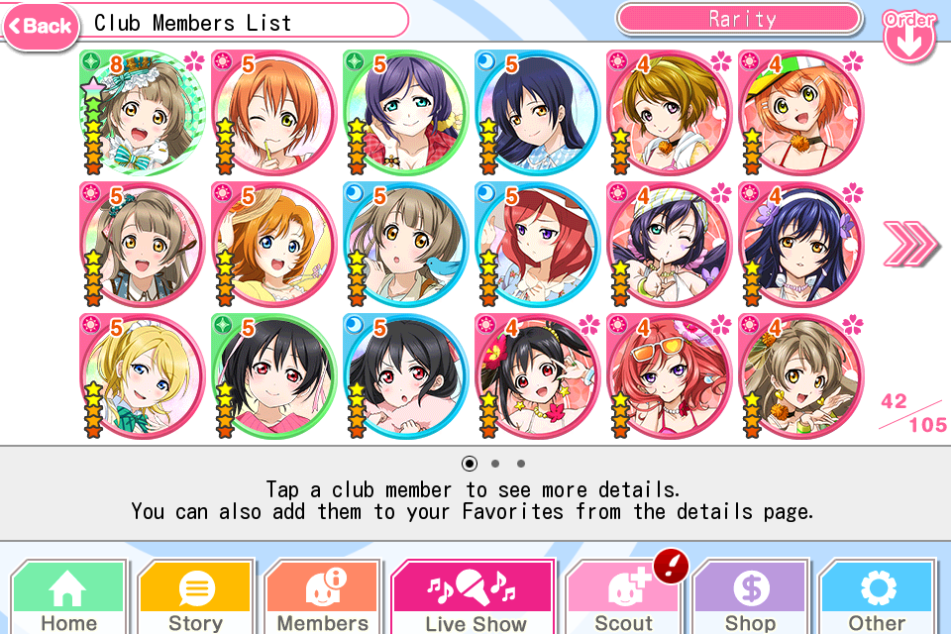
Your Title
Some info

Slide 9
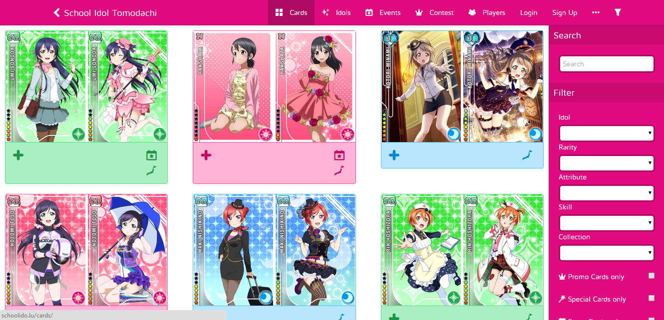
Your Title
Some info

Slide 10
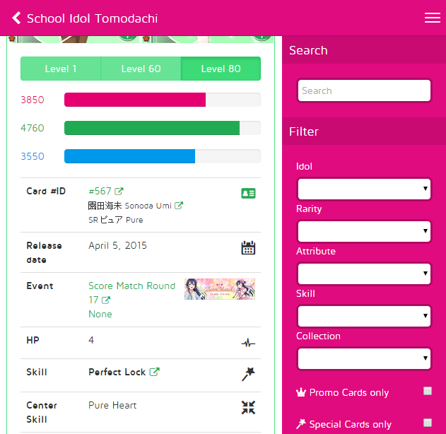
Your Title
Some info

Slide 11
Your Title
Some info

Slide 12

Your Title
Some info

Slide 13
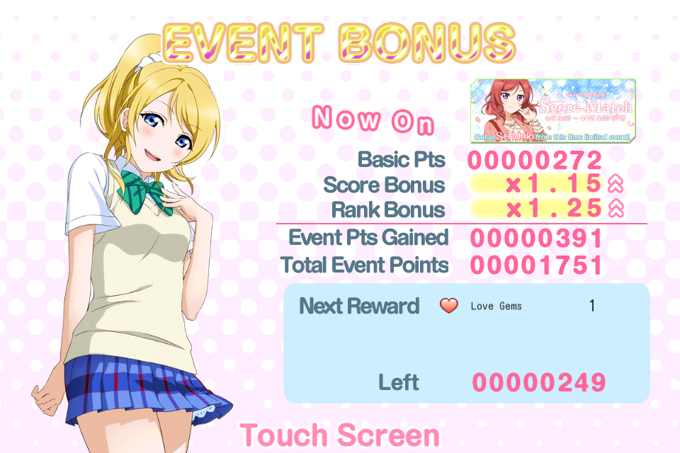
Your Title
Some info

Slide 14
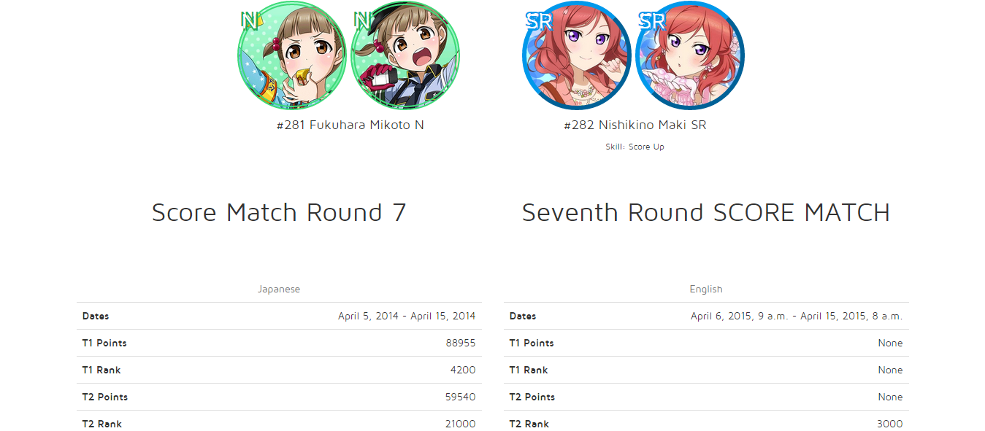
Your Title
Some info

Slide 15
Your Title
Some info

Slide 16
Your Title

Slide 17
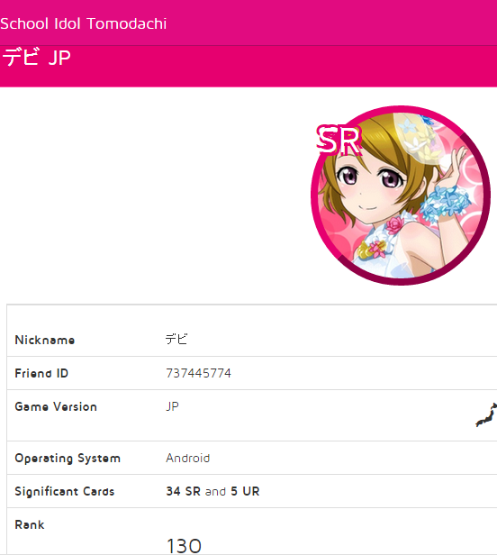
Your Title
Some info

Slide 18
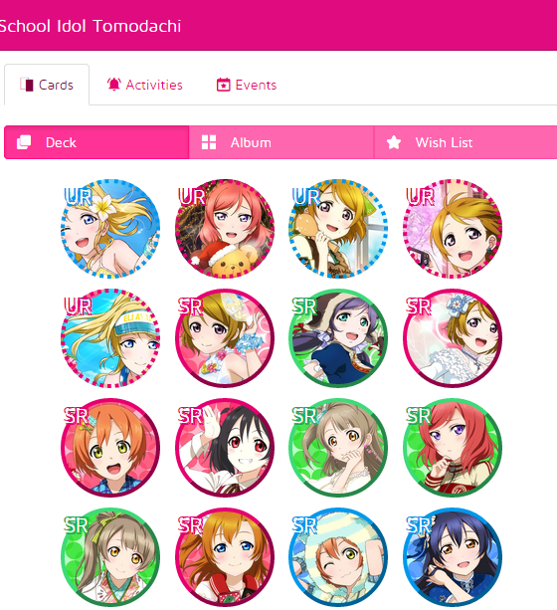
Your Title
Some info

Slide 19

Sources (list them)
http://schoolido.lu/

